Slide 1
MACHINE LEARNING CLUSTERING
By AMUDHA RAGHAVAN

Slide 2
Introduction
Connectivity – Clustering
AGGLOMERATIVE -- HIERARCHICAL
Grouping – Clustering
AFFINITIVE PROPAGATION
Centroid – Clustering
K-MEANS
Distributing Model – Clustering
GAUSSIAN MIXTURE
Density based spatial – Clustering
DBSCAN & MEAN_SHIFT
Balanced Iterative reducing – Clustering
BIRCH
Ordering points identify – Clustering
OPTICS

Slide 3
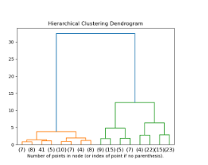
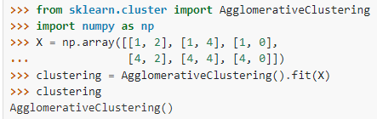
AGGLOMERATIVE - HIERARCHICAL
Hierarchy of clusters is represented as a tree – Dendrogram
The Agglomerative Clustering object performs a hierarchical clustering using a bottom up approach.
Each observation starts in its own cluster, and clusters are successively merged together
ALGORITHM: (https://github.com/eamudha/ML_CLASSIFIER)

Slide 4
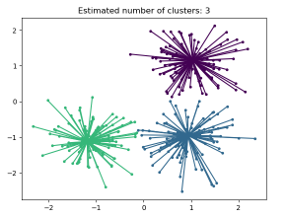
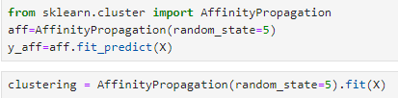
AFFINITY PROPOGATION - HIERARCHICAL
Affinity Propagation does not require the number of clusters to be specified
Used to cluster data points into multiple groups based on their similarity
Does not require the number of clusters to be specified
Can produce high-quality clusters even when the data points have different densities or sizes
Can be used to cluster data with complex relationships and non-linear structures.
Can be used in a wide range of applications: (IMAGE, GENE ANALYSIS)
ADVANTAGE
Can be computationally expensive
May not always produce the best results compared to: (K-Means or Gaussian Mixture Models)
Can be sensitive to the choice of similarity metric used to measure the similarities between data points.
making it difficult to interpret the results of the clustering process
DISADVANTAGE
ALGORITHM: (https://github.com/eamudha/ML_CLASSIFIER)

Slide 5
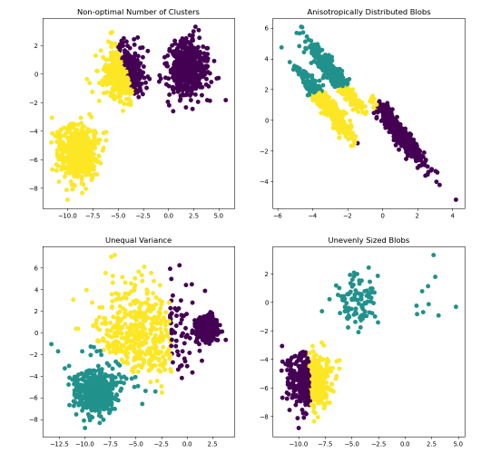

K-MEANS & MEAN SHIFT
CENTROID CLUSTERING
It is a centroid-based algorithm, where each cluster is associated with a centroid.
The main aim of this algorithm is to minimize the sum of distances between the data point and their corresponding clusters..
The K-means algorithm aims to choose centroids that minimize the inertia, or within-cluster sum-of-squares criterion
ALGORITHM: (https://github.com/eamudha/ML_CLASSIFIER)

Slide 6
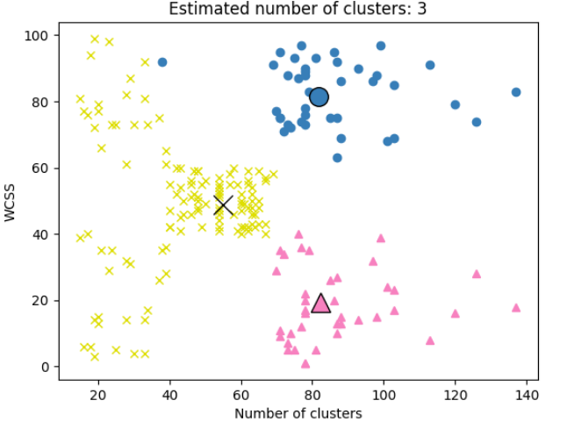
MEAN SHIFT
DENSITY BASED CLUSTERING
Mean_shift that assigns the data points to the clusters iteratively by shifting points towards the mode
Non-parametric, density-based clustering algorithm that can be used to identify clusters in a dataset
Main advantage of mean-shift clustering is that it does not require the number of clusters to be specified beforehand
The bandwidth kernel function is used to weight the data points when calculating the Mean_Shift
ALGORITHM: (https://github.com/eamudha/ML_CLASSIFIER)

Slide 7
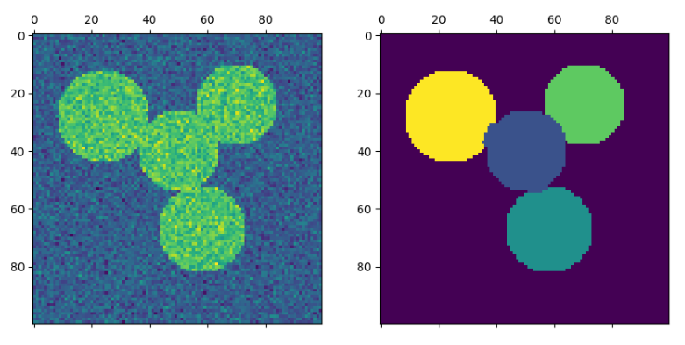
SPECTRAL
DENSITY CLUSTERING
The present version of Spectral Clustering requires the number of clusters to be specified in advance.
It works well for a small number of clusters, but is not advised for many clusters.
we can also use connectivity between the data point as a feature to cluster our data points.
Using connectivity we can cluster two data points into the same clusters even if the distance between the two data points is larger.
ALGORITHM: (https://github.com/eamudha/ML_CLASSIFIER)

Slide 8
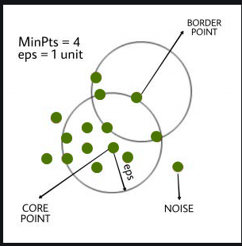
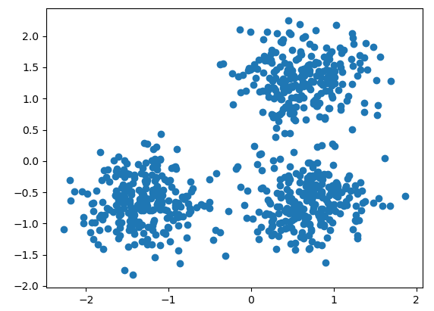
DBSCAN
DENSITY BASED CLUSTERING
Clusters are dense regions in the data space, separated by regions of the lower density of points.
The DBSCAN algorithm is based on this intuitive notion of “clusters” and “noise”.
The key idea is that for each point of a cluster, the neighborhood of a given radius has to contain at least a minimum number of points.
ALGORITHM: (https://github.com/eamudha/ML_CLASSIFIER)

Slide 9
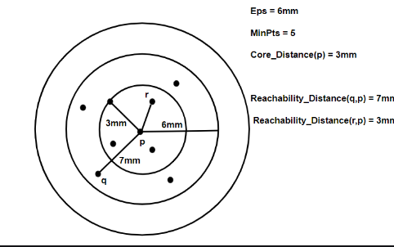
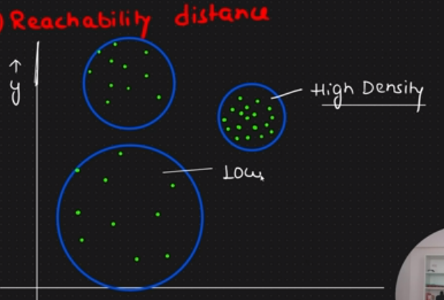
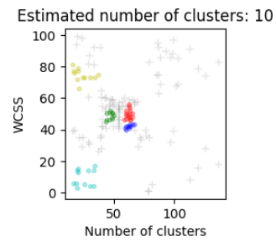

OPTICS
DENSITY BASED CLUSTERING
OPTICS Clustering stands for
Ordering Points To Identify Cluster Structure.
The DBSCAN algorithm is based on this intuitive notion of “clusters” and “noise”.
The main idea behind OPTICS is to extract the clustering structure of a dataset by identifying the density-connected points.
The algorithm builds a density-based representation of the data by creating an ordered list of points called the REACHABILITY PLOT.
ALGORITHM: (https://github.com/eamudha/ML_CLASSIFIER)

Slide 10
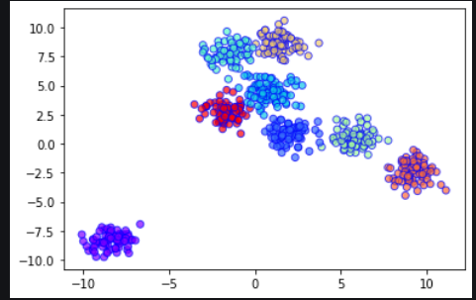
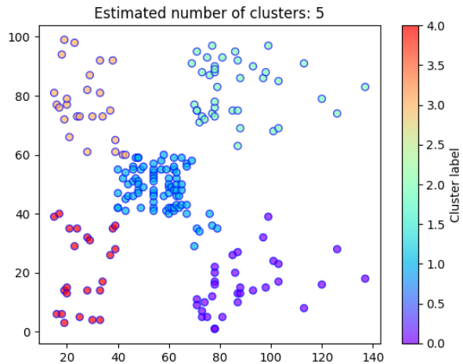
BERCH
DENSITY BASED CLUSTERING
Balanced Iterative Reducing and Clustering using Hierarchies (BIRCH)
This algorithm can cluster large datasets by first generating a small and compact summary of the large dataset that retains as much information as possible.
BIRCH has one major drawback – it can only process metric attributes. A metric attribute is any attribute whose values can be represented in Euclidean space i.e., no categorical attributes should be present
ALGORITHM: (https://github.com/eamudha/ML_CLASSIFIER)
the maximum number of data points a sub-cluster in the leaf node of the CF tree can hold
The maximum number of CF sub-clusters in each node (internal node)

Slide 11
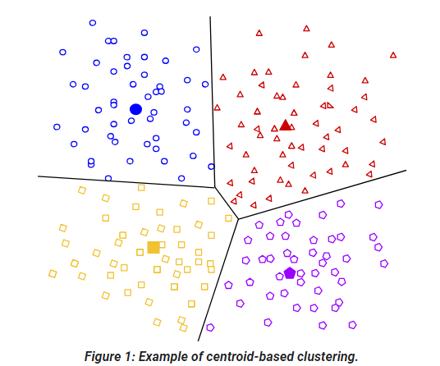
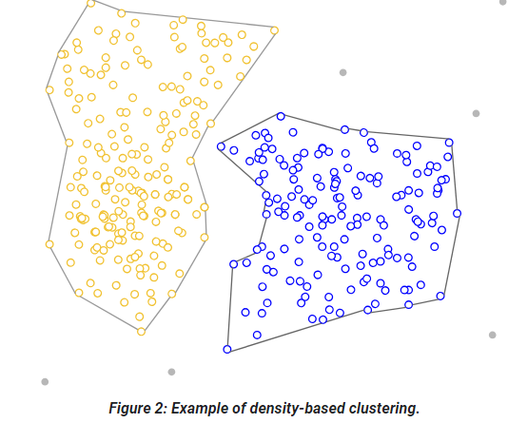
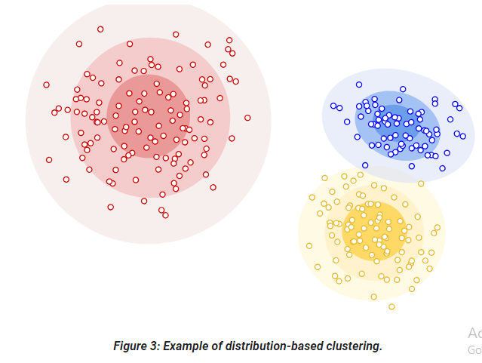
DIFFERENCE
DENSITY BASED, CENTROD, & DISTRIBUTION CLUSTERING
organizes the data into non-hierarchical clusters
k-means is the most widely-used
k-means – Efficient & Effective
CENTROID BASED
Healthcare
connects areas of high example density into clusters
difficulty with data of varying densities and high dimensions
allows for arbitrary-shaped distributions
DBSCAN
DENSITY BASED
clustering approach assumes data is composed of distributions
DISTRIBUTION
Gaussian Distribution
As distance from the distribution's center increases, the probability that a point belongs to the distribution decreases

Slide 12
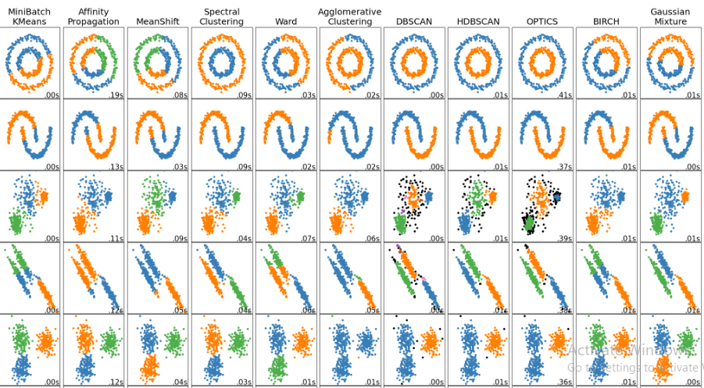
COMPARING DIFFERENT CLUSTERING ALGORITHMS

Slide 13

